Slide 1

Design of Android Phone Based Home Fire Alert System
Presentation for Design Lab Evaluation
by
VIKRAM PATEL
1701EE55
Under the Supervision of
Dr. Jawar Singh

Slide 2
INTRODUCTION
Amongst the occurred disasters happened in the resident area, fires have been known as the dangerous tragedy that could cause destruction, property and life losses.
In many disasters, fires have become recurrent, destructive and most influential disasters if compared to other hazards

Slide 3
MOTIVATION
The home fire alert system is purposely designed to alert the house residents whenever any possibilities for having fire disaster prompted in their house.
If early warnings are given, residents themselves can take immediate precaution from the fire and prevent its spread all over by using fire extinguisher or call the fireman instantly.

Slide 4
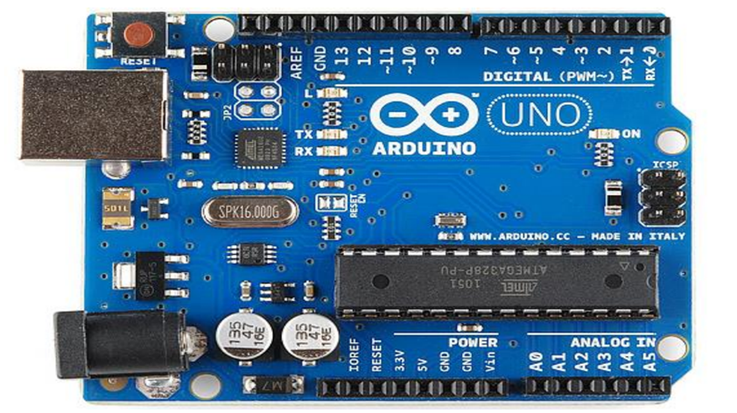
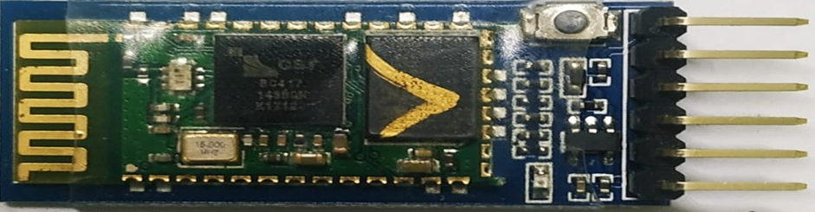
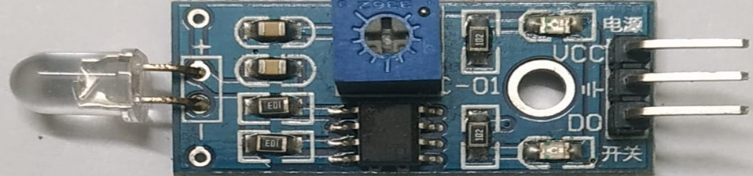
COMPONENTS USED
Arduino Uno
Bluetooth module HC-05
Flame sensor
16x2 LCD
Relay Module
DC fan
Breadboard
Connecting Wires

Slide 5
METHODOLOGY
When the system is powered on, Flame sensor will sense any surrounding Fire. Whenever a Fire is detected, microcontroller on the Arduino UNO board will send an alert message to the user with the help of Bluetooth Module(HC-05). Also, a message is displayed ON the LCD Display connected with Arduino.
Now relay will turn on and connected fan/water sprinkler will be also switched on.

Slide 6
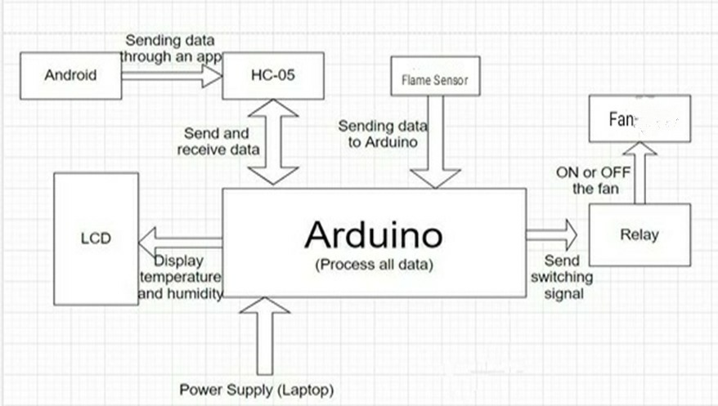
BLOCK DIAGRAM FOR THE DESIGN

Slide 7
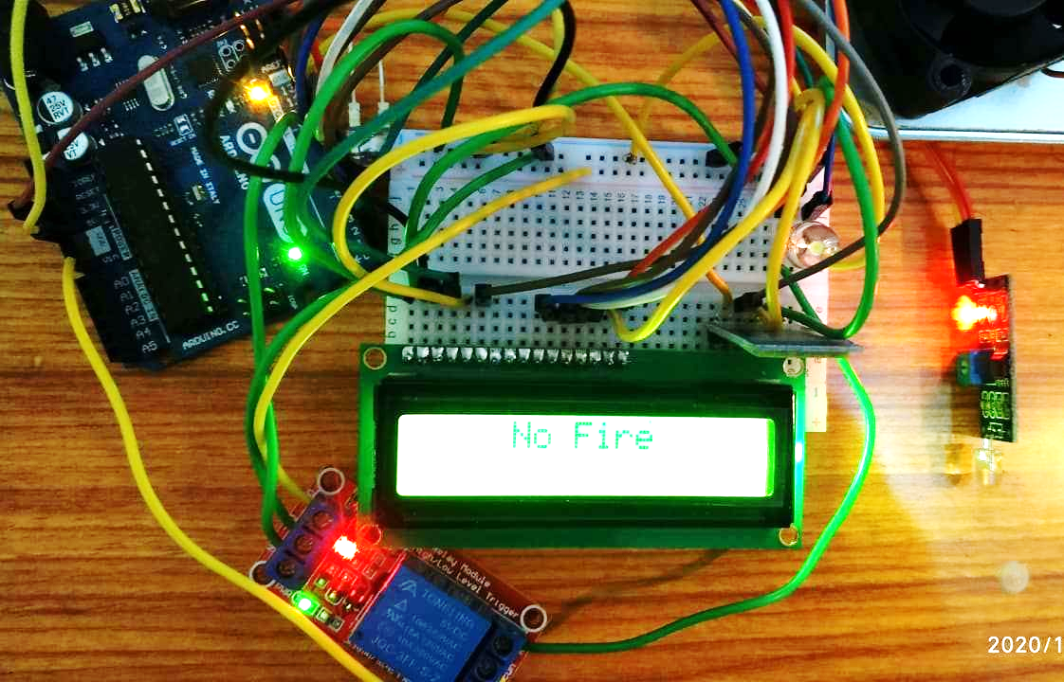
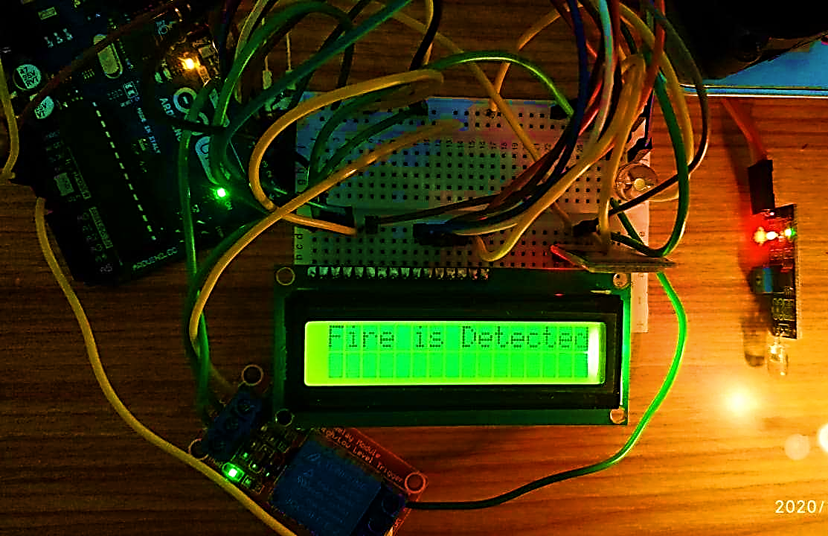
EXPERIMENTAL SETUP AND WORKING

Slide 8
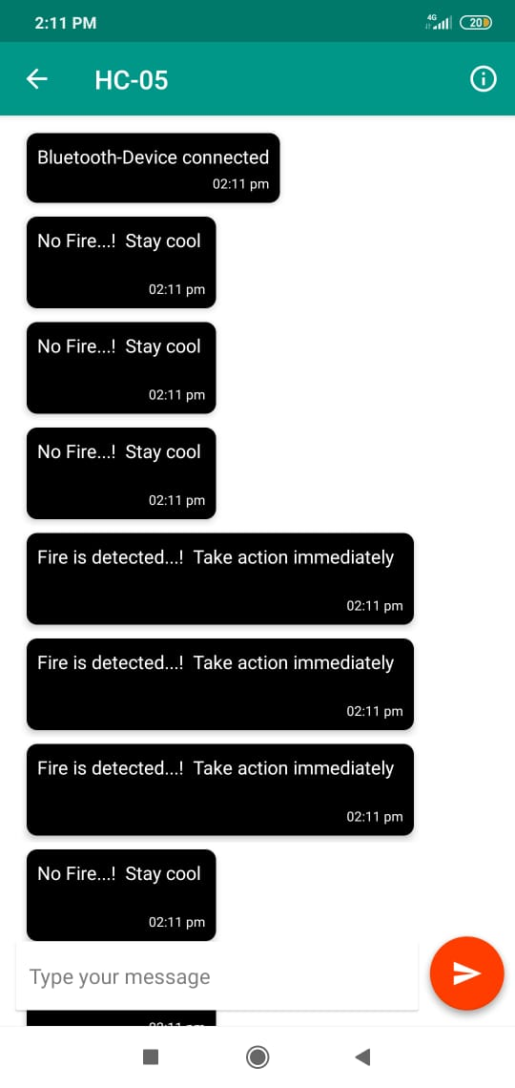
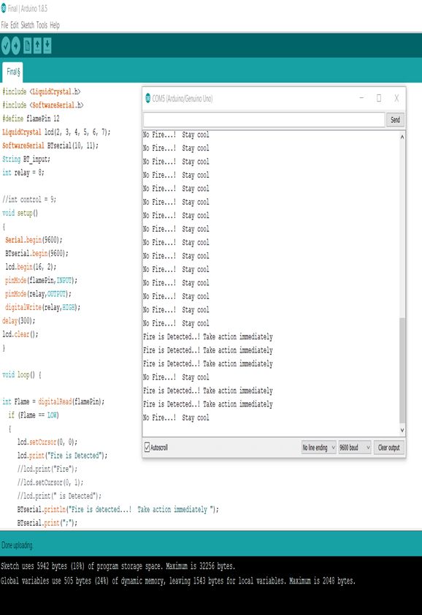

Slide 9
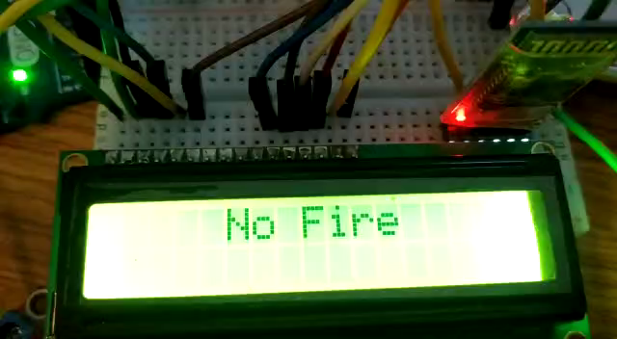
DEMONSTRATION VIDEO

Slide 10
CONCLUSION
This project has been made in order to help building owner to overcome the problem which is fire spreading whenever the owner is not in the building.
The novelty in this project is although there are many fire alert system projects but in this project Android phone support is also there. Also the fire condition has been displayed on LCD and android phone, which can again be used for further advancements.
Based on the results obtained, the fire alert system design is doable and can be helpful to the residents to protect their houses.

Slide 11
REFERENCES
Mahzan, Najwa & Md Enzai, Nur & Zin, N & Noh, K. (2018). “Design of an Arduino-based home fire alarm system with GSM module”. Journal of Physics: Conference Series. 1019. 012079. 10.1088/1742-6596/1019/1/012079.
K Sen, J Sarkar, S Saha, A Roy, D Dey, and S Baitalik, “Automated Fire Detection and Controlling System,” Int. Adv. Res. J. Sci. Eng. Technol., vol. 2, no. 5, pp. 34–37, 2015.

Slide 12
THANK YOU

